Slide 1

SoK: A Framework and Guide for Human-Centered Threat Modeling in Security and Privacy Research
Warda Usman, Daniel Zappala

Slide 2
How does one study the threat models of Pakistani immigrants living in the US?
Notes:
When I was starting a study on how Pakistani immigrants in the US navigate security and privacy risks — I wanted to ground the work in how people perceive threats in their daily lives. So I went to my advisor, Dr Zappala, and asked: How do I study threat models? What’s included? What’s the right way to approach this? And he didn’t have a clear answer. He almost wished there was some sort of guide he could hand me. But there was no guide or framework on how to do this work effectively.
So we started doing what many of you probably would have done — reading through the literature to see how other researchers had studied similar problems.

Slide 3

at-risk individuals
Notes:
And we discovered a lot of incredible research in this space, much of it done by people in this room. We have work on at-risk populations

Slide 4

at-risk individuals
threats from technology
Notes:
on technology-specific risks

Slide 5

at-risk individuals
threats from technology
narratives of threat experience
Notes:
On specific threat experiences such as harassment. But there wasn’t a shared way of talking about what threat modeling looks like when the focus is on people.
Some papers explicitly called what they were doing 'threat modeling.' Others clearly were doing it, but didn’t use the term at all. Even when the terminology were similar, the scope varied: some focused narrowly on identifying threats, others explored coping strategies, barriers, or systemic harms.
That variation isn’t a weakness. Because humans are so diverse, the work that studies them HAS to be nuanced and diverse.

Slide 6
Lack of a systematization makes it:
hard for new researchers to do this work well
Notes:
But this diversity does make it harder for new researchers, like me, to understand how to approach this kind of study

Slide 7
Lack of a systematization makes it:
hard for new researchers to do this work well
hard to
build on each other’s findings
Notes:
and harder for all of us to build on each other’s findings

Slide 8
Lack of a systematization makes it:
hard for new researchers to do this work well
hard to understand the S&P needs of people
hard to
build on each other’s findings
Notes:
And most importantly, it becomes harder to fully understand the security and privacy needs of the people and communities we’re trying to support.
So this work that I'm presenting today is our attempt to systematize human centered threat modeling

Slide 9
What is Human-Centered Threat Modeling?
Process to identify how people perceive and respond to risks to themselves
Centered on a person or community
Includes the entire process of managing risks including identifying them, responding to them, and reflecting
Notes:
So what do I mean by human centered threat modeling? We define it as “a process to identify how people perceive and respond to risks to themselves. The process is centered on a person or community and grounded in understanding the context in which they operate. It includes the entire process of managing risks, including identifying them, responding to them, and reflecting on how existing behaviors and societal structures can be adapted to better manage risks in the future.”

Slide 10
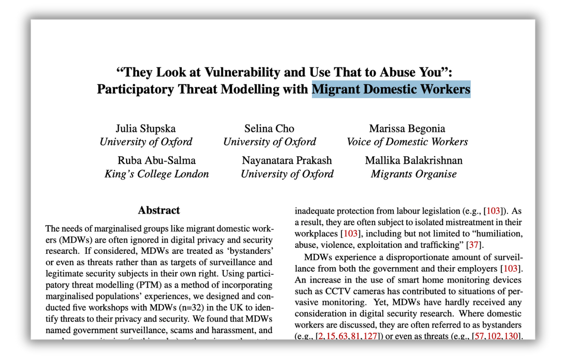
What is Human-Centered Threat Modeling?
Notes:
Before I get into the details of what we did for our study. I’d like to show you some examples of works that we categorize as human-centered threat modeling. We saw this kind of work across the field — sometimes named as threat modeling, but often not. For example, this work with migrant domestic workers captured how participants defined threats, described experiences of surveillance and abuse, and imagined safer futures.

Slide 11
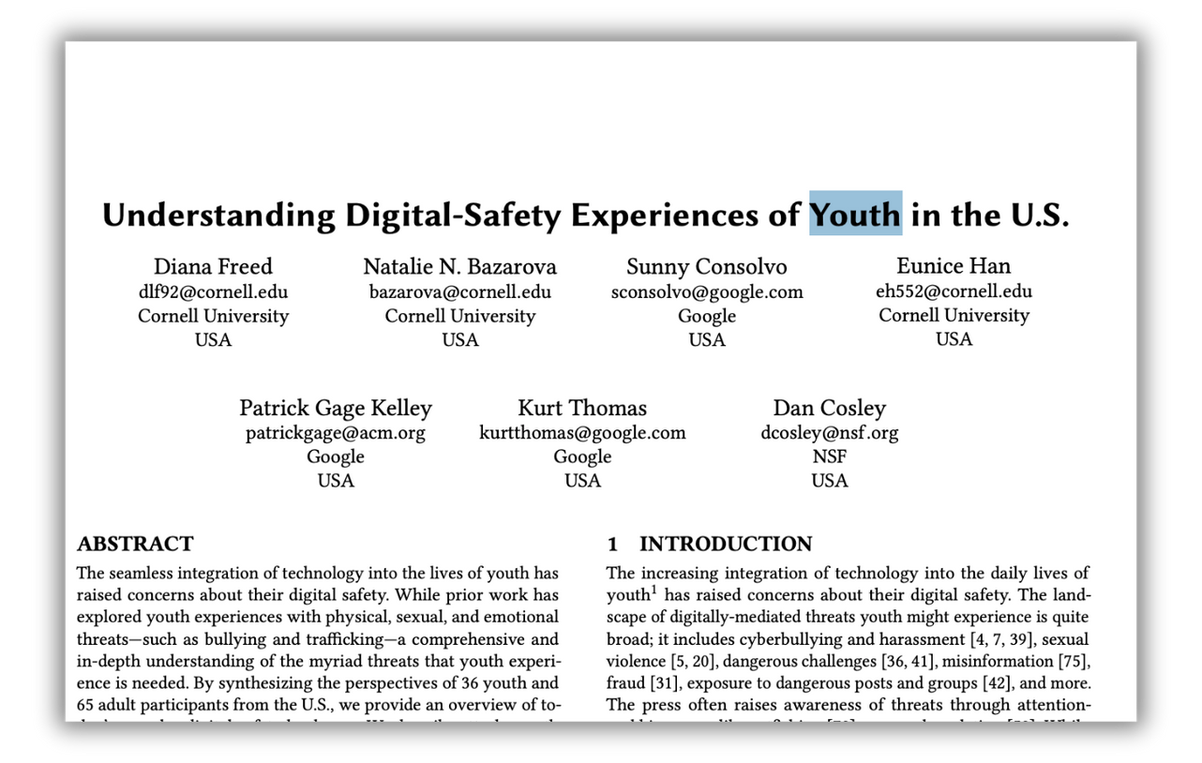
What is Human-Centered Threat Modeling?
Notes:
Then there is similar work with youth

Slide 12
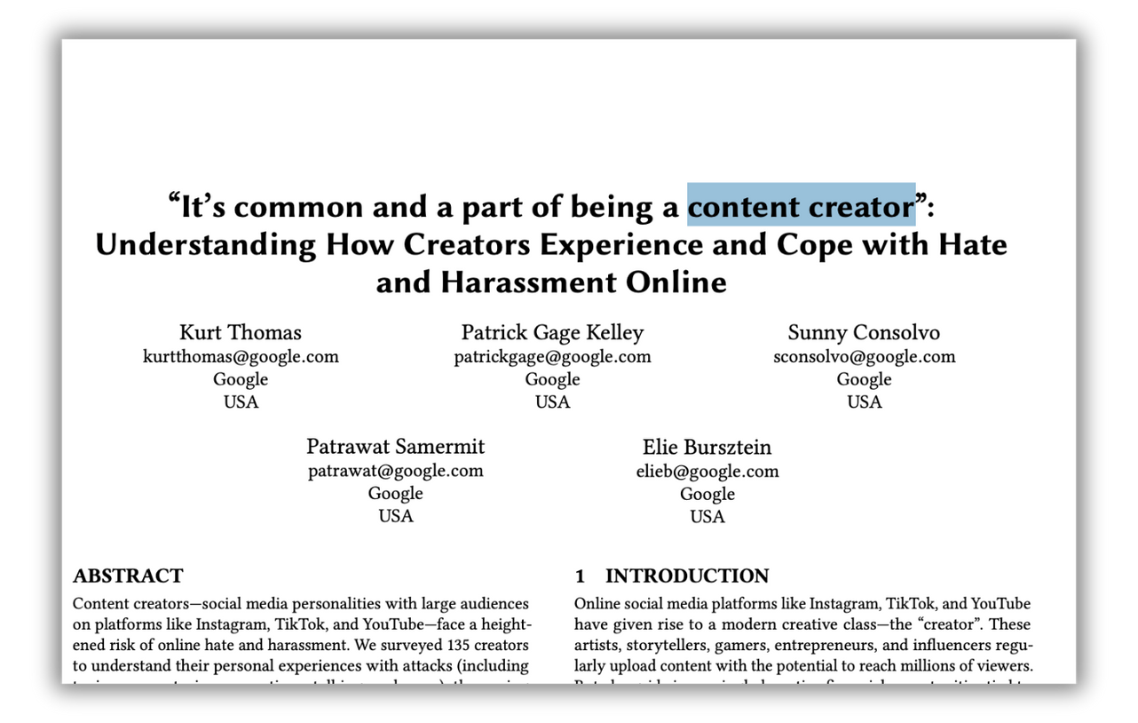
What is Human-Centered Threat Modeling?
Notes:
And content creators,

Slide 13
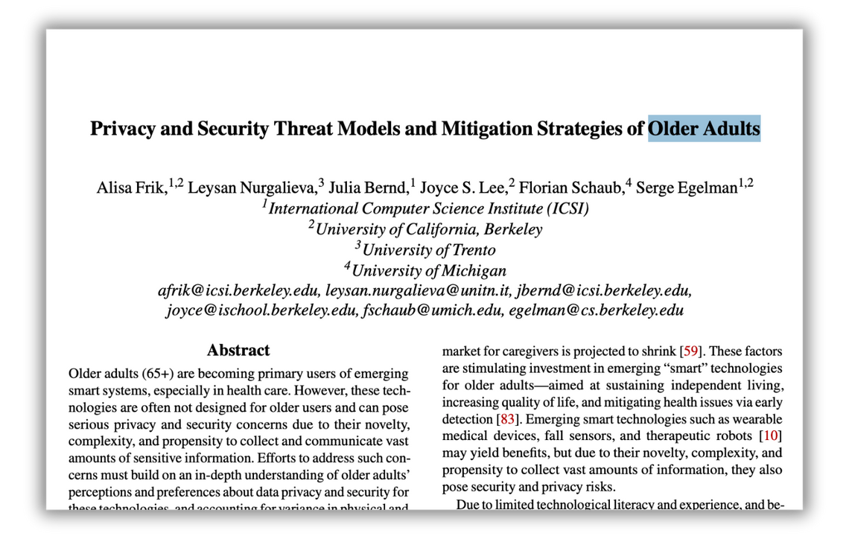
What is Human-Centered Threat Modeling?
Notes:
Older adults

Slide 14
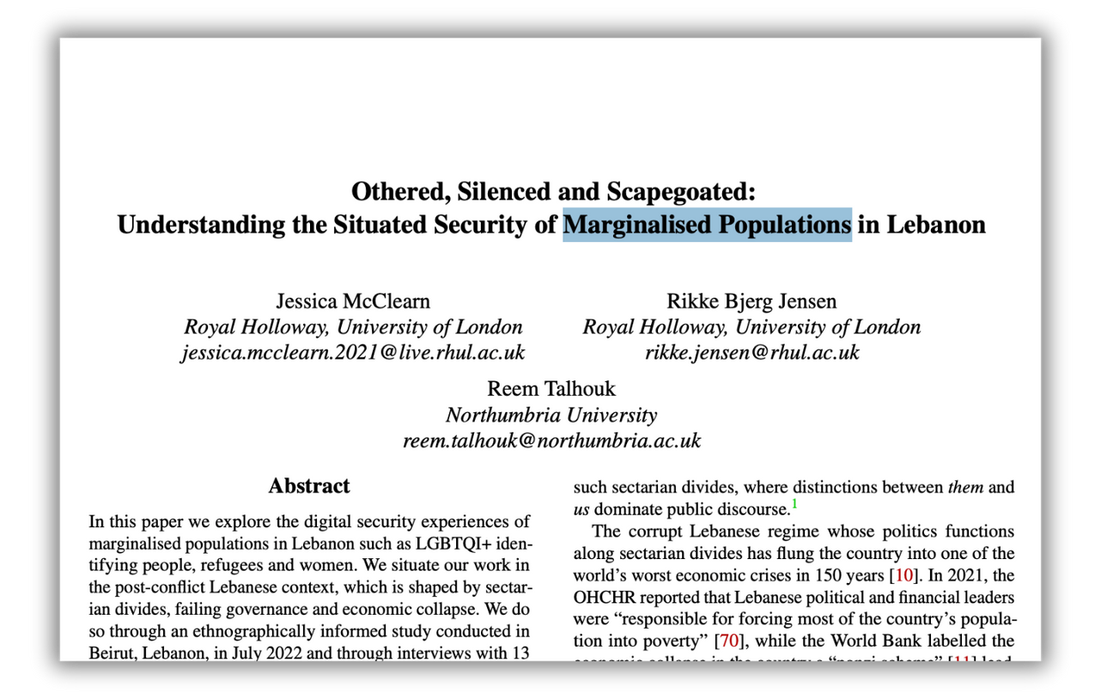
What is Human-Centered Threat Modeling?
Notes:
Marginalized populations in specific locations

Slide 15
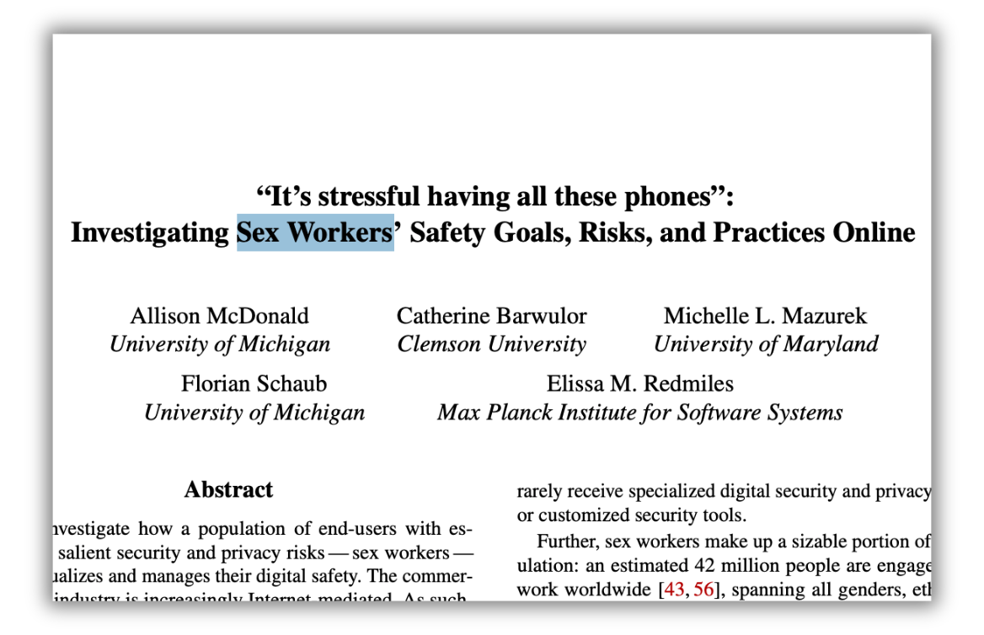
What is Human-Centered Threat Modeling?
Notes:
Sex workers

Slide 16
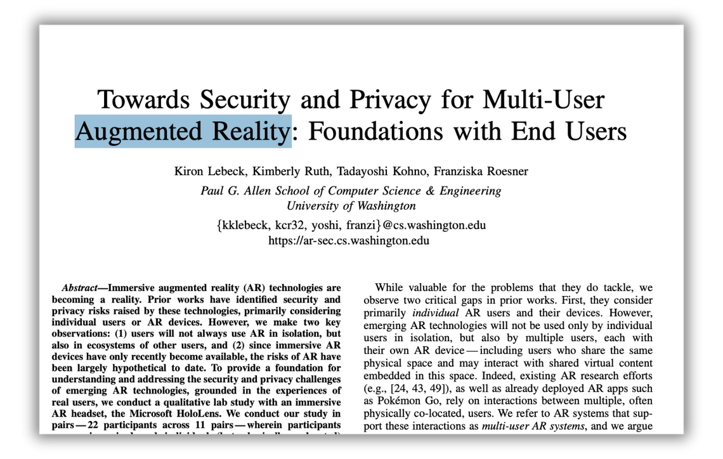
What is Human-Centered Threat Modeling?
Notes:
Threats from technologies, like augmented reality

Slide 17
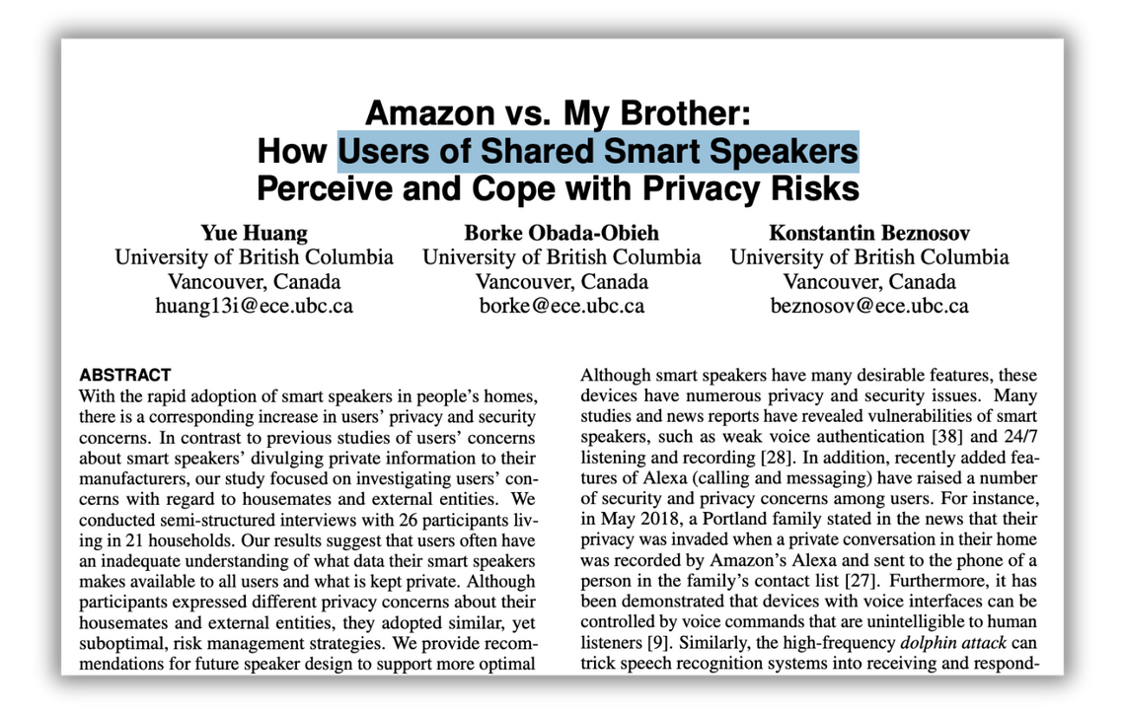
What is Human-Centered Threat Modeling?
Notes:
Threats to users of shared smart speakers…and so many others like these. Whats common across all of these, is that they're studying threat TO PEOPLE, as perceived BY THE PEOPLE. We call this area of research human centered threat modeling.

Slide 18
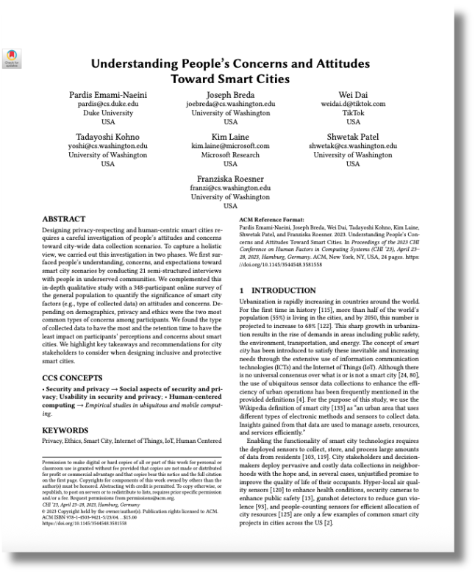
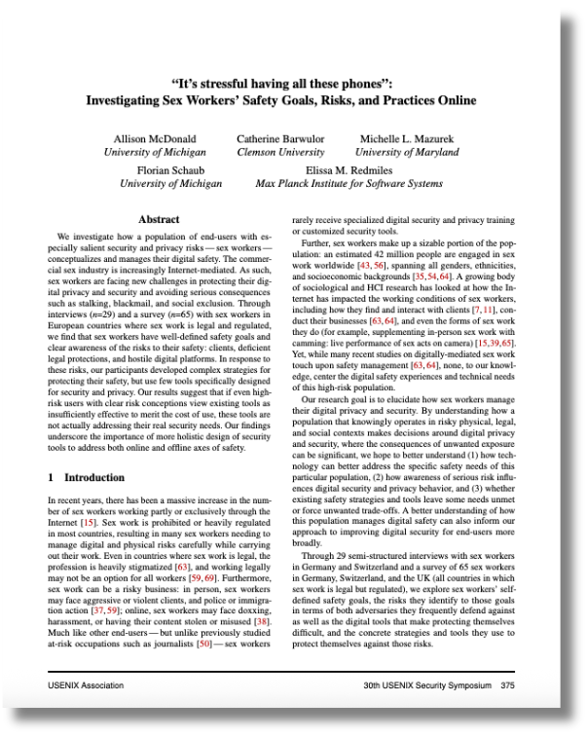
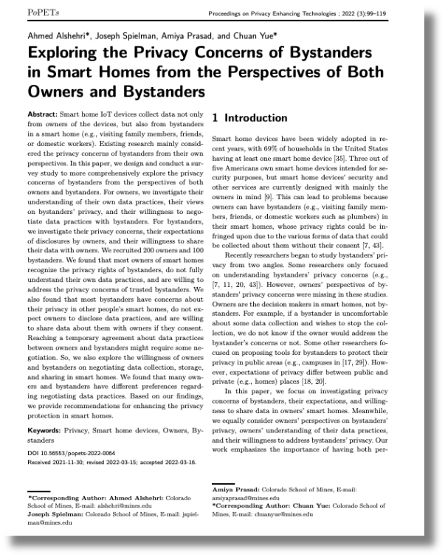
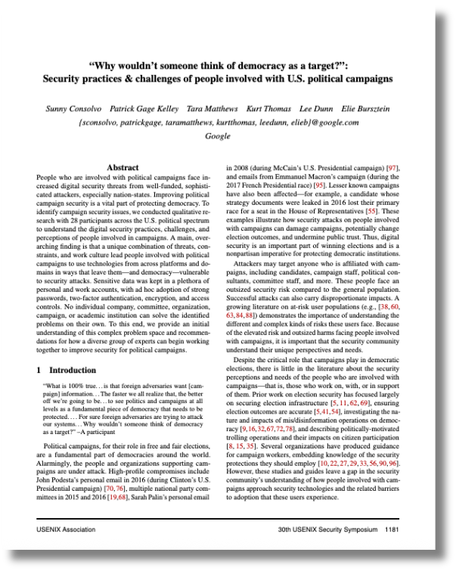
Data Collection and Analysis
Collected security, privacy, and HCI papers from 2018-2023
Notes:
Now, the methods. (twice) We collected security, privacy and HCI papers from 2018-2023

Slide 19
Data Collection and Analysis
Collected security, privacy, and HCI papers from 2018-2023
Phase I: Collect titles, abstracts, publication date and link
Notes:
Our corpus collection was done in three phases. For the first, we collected titles, abstracts, and links to each publication

Slide 20
Data Collection and Analysis
Collected security, privacy, and HCI papers from 2018-2023
Phase I: Collect titles, abstracts, publication date and link
9200 papers
Notes:
Which gave us a total of 9200 papers

Slide 21
Data Collection and Analysis
Collected security, privacy, and HCI papers from 2018-2023
Phase I: Collect titles, abstracts, publication date and link
Phase II: Review titles, abstracts to determine relevance
Notes:
In phase two, we narrowed it down by reading titles and abstracts. We maintained a broad definition of relevance at this time

Slide 22
Data Collection and Analysis
Collected security, privacy, and HCI papers from 2018-2023
Phase I: Collect titles, abstracts, publication date and link
Phase II: Review titles, abstracts to determine relevance
165 papers
Notes:
And ended up with 165 papers

Slide 23
Data Collection and Analysis
Collected security, privacy, and HCI papers from 2018-2023
Phase I: Collect titles, abstracts, publication date and link
Phase II: Review titles, abstracts to determine relevance
Phase III: Check against inclusion criteria:
Primary purpose: threat modeling
Threats to people
Perceived by people
Notes:
Finally, we developed an inclusion criteria which included the paper’s primary purpose to be threat modeling, whether or not it calls it that, it understands threats to people, not systems, and threats as perceived by the participants themselves, not by the researchers

Slide 24
Data Collection and Analysis
Collected security, privacy, and HCI papers from 2018-2023
Phase I: Collect titles, abstracts, publication date and link
Phase II: Review titles, abstracts to determine relevance
Phase III: Check against inclusion criteria:
Primary purpose: threat modeling
Threats to people
Perceived by people
78 papers
Notes:
We ended up with a final total of 78 papers, on which we did a qualitative analysis

Slide 25
Data Collection and Analysis
Collected security, privacy, and HCI papers from 2018-2023
Phase I: Collect titles, abstracts, publication date and link
Process
Phase II: Review titles, abstracts to determine relevance
Definitions
Phase III: Check against inclusion criteria:
Primary purpose: threat modeling
Threats to people
Perceived by people
Components
78 papers
Notes:
We extracted their definitions, process, components they included, among other things

Slide 26
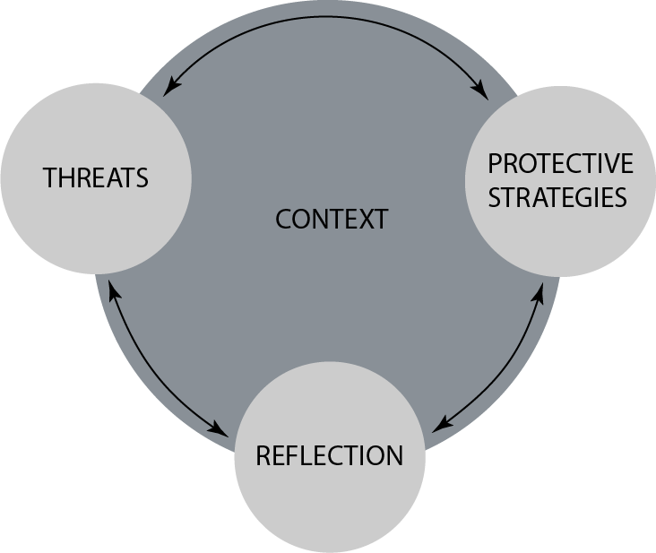
Framework Overview
Notes:
And developed a framework with 4 components: context, threats, protective strategies, and reflection. I’ll talk about each of these one by one. And share an exemplary paper for each that studied that component really well.

Slide 27
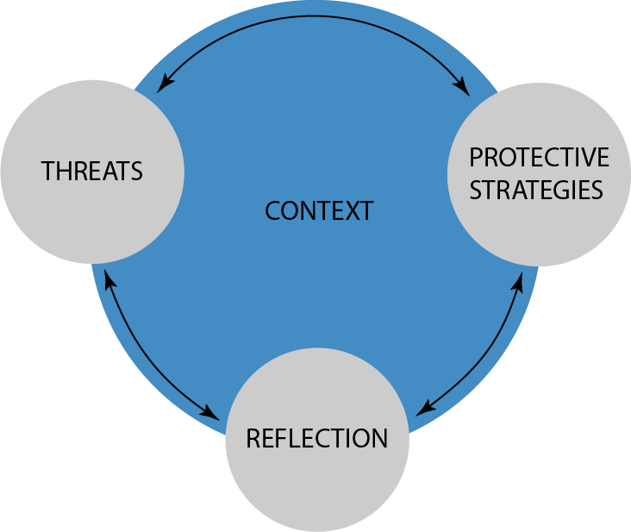
Framework Overview
Notes:
I’ll begin with context, around which the other three components are centered

Slide 28
Context
Circumstances, environment, and situational factors of an individual or population
Notes:
We define it as the “Circumstances, environment, and situational factors of an individual or population"

Slide 29
Context
Circumstances, environment, and situational factors of an individual or population
Risk factors
Unique challenges
Culture
Personal identity and perception
Technology background and usage
Notes:
We further divided it into risk factors, unique challenges, culture, personal identity, and technology background. These are factors that researchers should consider studying, because they do affect the threat perceptions of people.

Slide 30
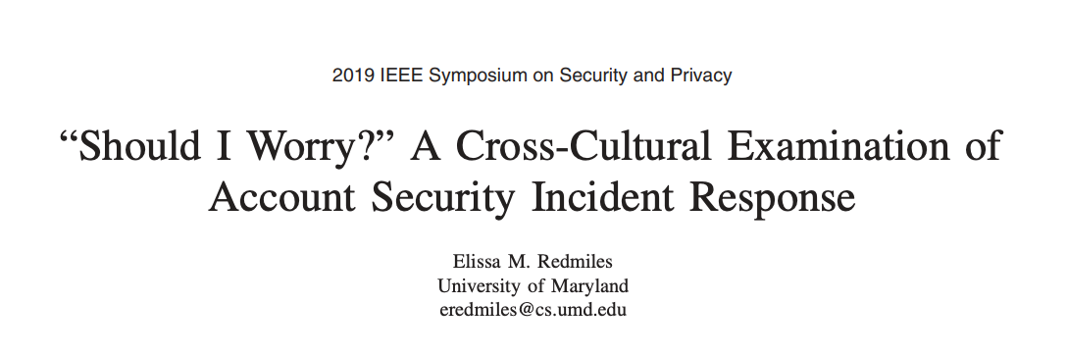
Context
Circumstances, environment, and situational factors of an individual or population
Risk factors
Unique challenges
Culture
Personal identity and perception
Technology background and usage
Notes:
For example, in this cross cultural study of account security incidence response, the collectivist cultural identity of participants shaped their threat models. In their case, people from more collectivistic cultures were more concerned about someone they knew gaining access to their account than an unknown “hacker”.

Slide 31
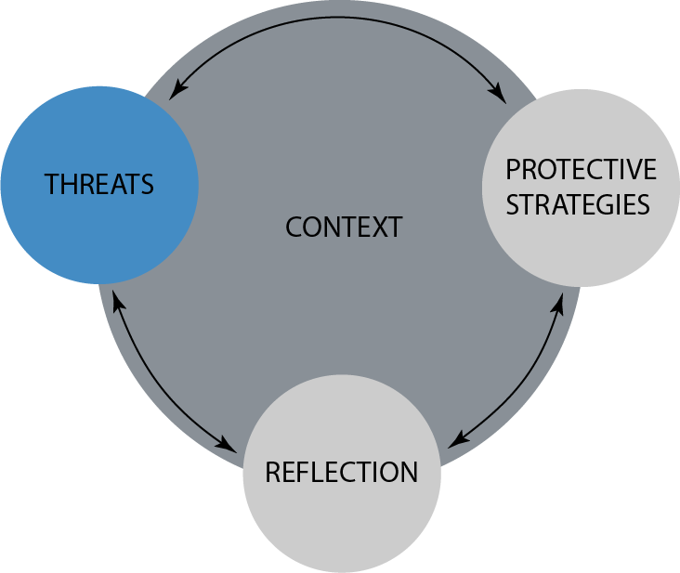
Framework Overview
Notes:
The second component is threats

Slide 32
Threats
Perceived events that could adversely impact safety
Notes:
Threats are the perceived events that could adversely impact safety

Slide 33
Threats
Perceived events that could adversely impact safety
Concerns
Harms
Actors
Trade-offs
Considerations
Threat appraisal
Notes:
This includes their concerns, specific harms, actors, and a couple of considerations

Slide 34
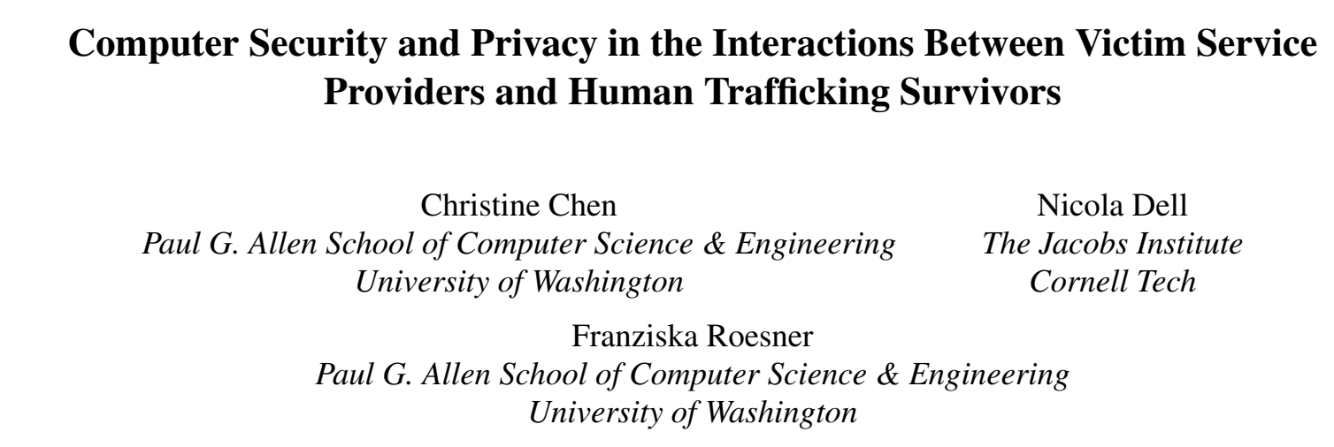
Threats
Perceived events that could adversely impact safety
Concerns
Harms
Actors
Trade-offs
Considerations
Threat appraisal
Notes:
Threats are often intertwined between the offline and online lives of participants. For example, This paper showed how survivors feared real-life offline harm from online public info available about them

Slide 35
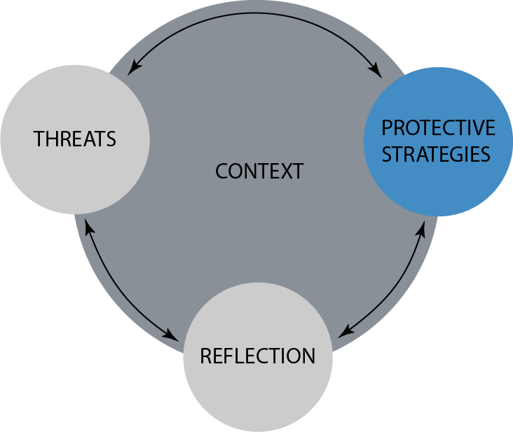
Framework Overview
Notes:
Third, protective strategies

Slide 36
Protective Strategies
Measures taken in order to protect digital safety, privacy, and security
Notes:
These are the measures taken by people to protect their safety, privacy, and security

Slide 37
Protective Strategies
Measures taken in order to protect digital safety, privacy, and security
Recovery
Information Seeking
Defenses
Mapping
Considerations
Perceived cost
Coping appraisal
Notes:
This includes recovering from an adverse event, seeking information, and defense actions

Slide 38
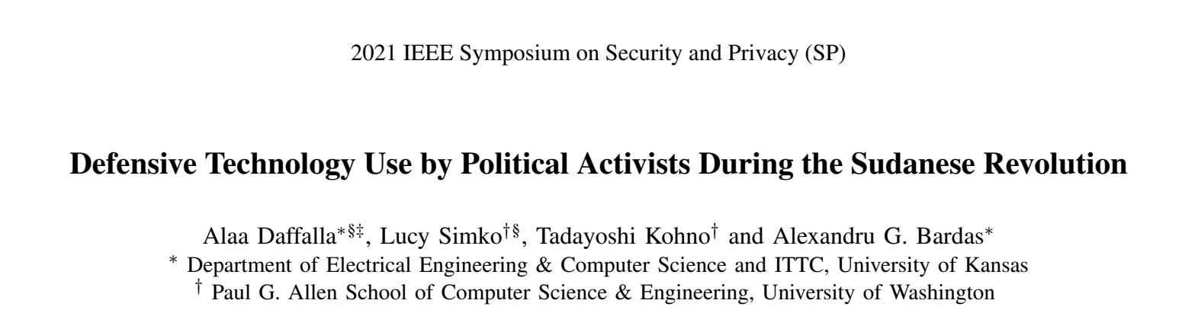
Protective Strategies
Measures taken in order to protect digital safety, privacy, and security
Recovery
Information Seeking
Defenses
Mapping
Considerations
Perceived cost
Coping appraisal
Notes:
For example, this work with political activists described some technical defenses of activists, such as: using encrypted apps, some behavioral defenses: such as: self-censorship.
Other papers in our corpus have also listed Offline defenses: such as putting a piece of tape on the laptop’s camera

Slide 39
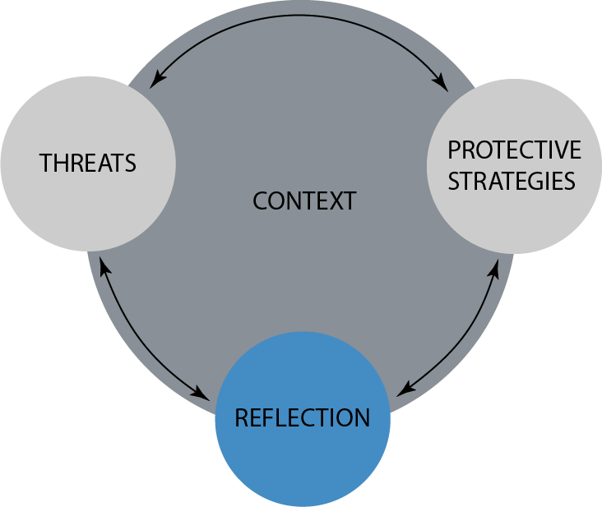
Framework Overview
Notes:
And finally, reflection. This is by far the least prevalent component included in papers.

Slide 40
Reflection
Assessment of protective strategies or broader societal changes needed to achieve security and privacy goals
Notes:
Reflection is defined as an assessment of protective strategies or broader societal changes needed to achieve security and privacy goals

Slide 41
Reflection
Assessment of protective strategies or broader societal changes needed to achieve security and privacy goals
Efficacy
Barriers
Advice
Visioning
Notes:
This includes efficacy of current practices, barriers to safety, advice received and shared, and envisioning a safer future with the participants.

Slide 42
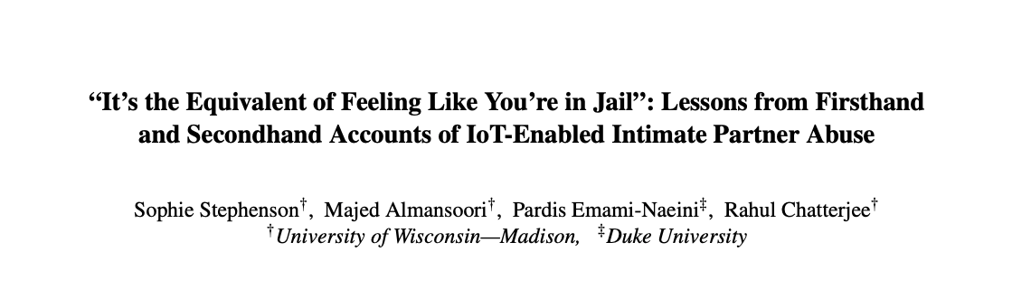
Reflection
Assessment of protective strategies or broader societal changes needed to achieve security and privacy goals
Efficacy
Barriers
Advice
Visioning
Notes:
One example is this paper, Survivors reported a large number of barriers to identifying and mitigating abuse. So whatever solutions we design for them, we HAVE to consider those barriers!

Slide 43
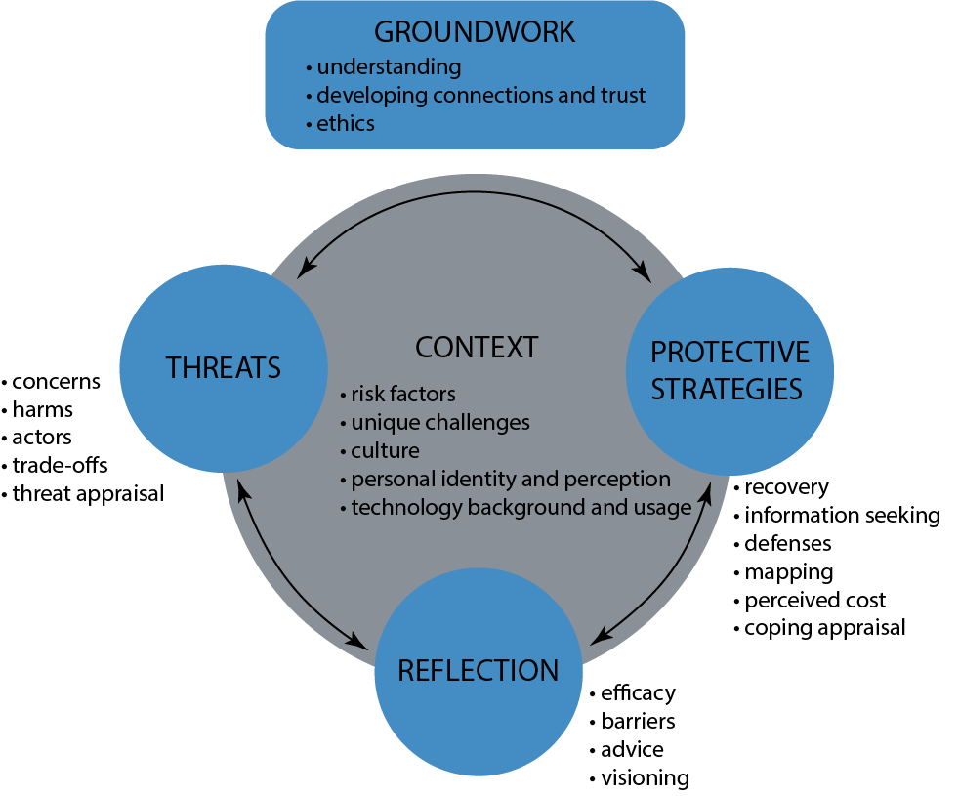
Framework Overview
Notes:
The framework provides a START on what to consider when studying harms to people. In the paper we talk about some additional items that would be helpful for a researcher to consider. Such as groundwork.

Slide 44
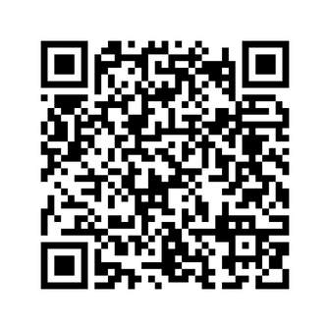
Also in the paper
Please find us in the poster session for any questions
Guidelines for using the framework
Contact:
Warda Usman
warda97@byu.edu
Daniel Zappala
zappala@cs.byu.edu
Considerations when using the framework
What translates from systems threat modeling
Scan to read the paper
Call for centering human-safety
Notes:
As well as some guidelines and considerations when using the framework. We also talk about what translates to human-centered threat modeling from systems threat modeling, and a call for centering human-safety. Please read our paper for those details, and find us in the poster session for any questions.

